Slide 1
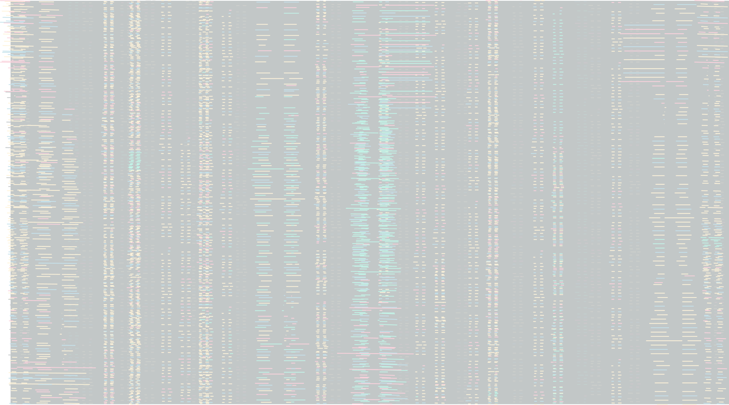





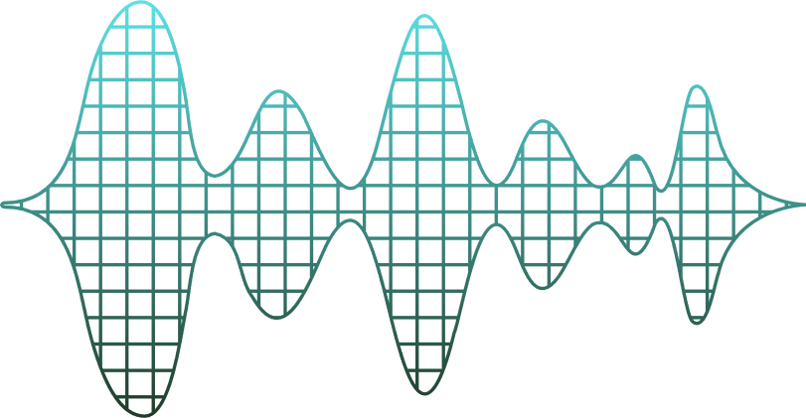
PhishGuard
PRESENTATION

Slide 2
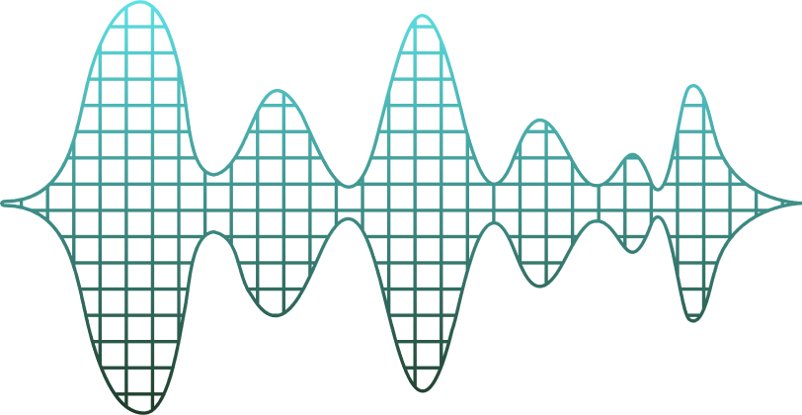


TABLE OF CONTENTS
01.
02.
03.
What is PhishGuard
Development process
Our final
product

Slide 3


Our topic
01.
Passion project
Cybersecurity
Phishing
Sensitive information

Slide 4





Our solution
01.
PhishGuard
Interactive web-based game
Gamified cybersecurity education
Our goal
Engaging, active learning experience
Improve user's ability to detect phishing

Slide 5



Target audience
01.
Students
Employees
Organizations

Slide 6



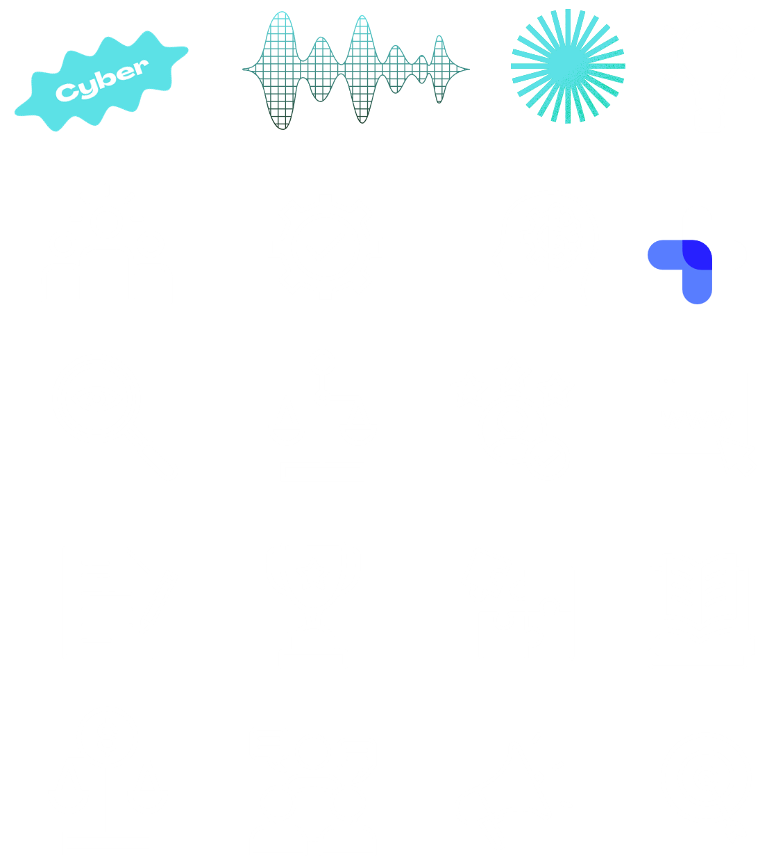

Design
02.
Choices
Figma
Changes

Slide 7


Realisation
02.
Front end
Back end
Vue.js, HTML, CSS, TailwindCSS, HeadlessUI & HeroIcons
JavaScript, TypeScript, Nuxt Nitro & PostGreSQL

Slide 8




Demo
03.

Slide 9


Q & A
03.

Slide 10
THANKS FOR YOUR ATTENTION !

